Slide 1


K.RAMAKRISHNAN COLLEGE OF TECHNOLOGY (AUTONOMOUS), TRICHY
SIMPLE FILTERING AND SORTING
USING R
PRESENTED BY
2303811724321091-ROSHITH S
GUIDED BY
Mrs.S.MURUGAVALLI, AP/AI

Slide 2
PRESENTATION OVERVIEW
Problem Identification
Objective
Dataflow Diagram
List of Modules
Module Description
Implementation Screenshots
Conclusion

Slide 3
PROBLEM IDENTIFICATION
Many users work with large CSV datasets but lack tools to interactively explore or clean them.
Manual filtering and sorting in Excel or static scripts is time-consuming and error-prone.
Existing dashboard tools may require programming knowledge or are overly complex.
There's a need for a user-friendly dashboard to upload, sort, and filter data.

Slide 4
OBJECTIVE
The goal is to make data exploration simple, fast, and accessible to non-technical users. It provides dynamic sorting and filtering based on selected columns and data types.

Slide 5
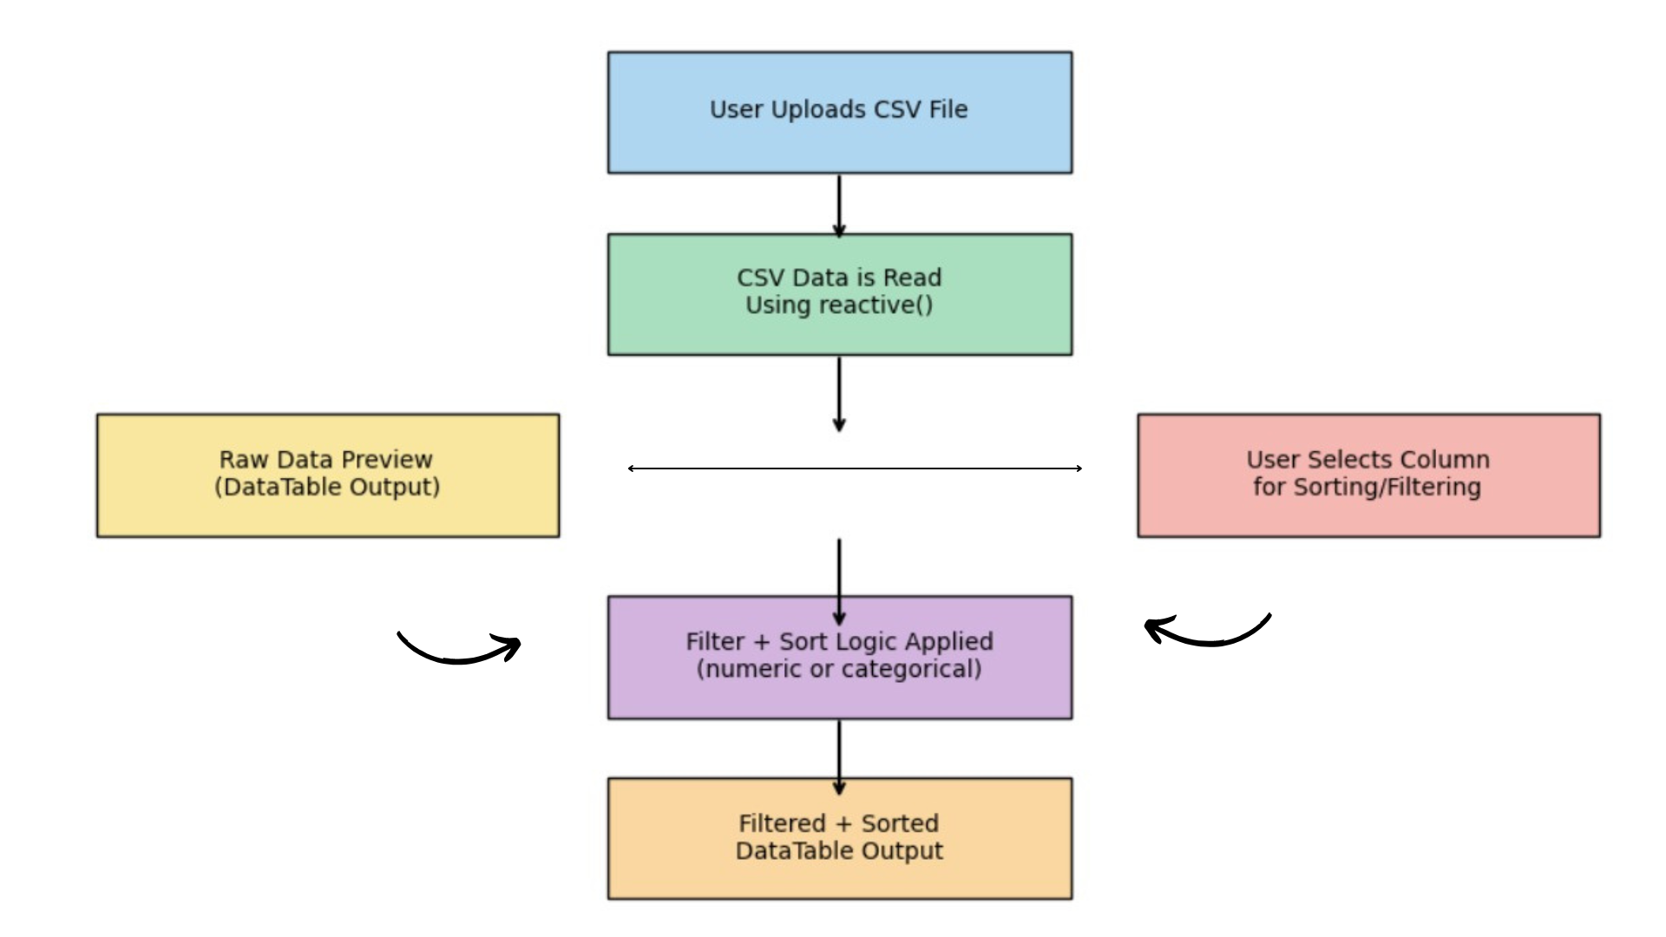
DATAFLOW DIAGRAM

Slide 6
LIST OF MODULES
CSV Upload Module
Raw Data Display Module
Column Selection Module
Sorting & Filtering Module
Result Table Display Module
2/7/20

Slide 7
MODULES DESCRIPTION
CSV Upload Module: Let the user upload a .csv file from their local system; supports any delimiter.
Raw Data Display Module: Shows the unprocessed data in a scrollable and searchable table using DT::data table.
Column Selection Module:
Dynamically lists all column names after file upload; used to target sorting/filtering.

Slide 8
MODULES DESCRIPTION
Sorting & Filtering Module:
For numerical columns: uses sliderInput to set minimum value.
For categorical columns: uses selectInput to filter by exact match.
Sorting is handled using order() based on user-selected order.
Result Table Display Module:
Outputs the sorted and filtered data in a responsive, paginated table using DT.

Slide 9

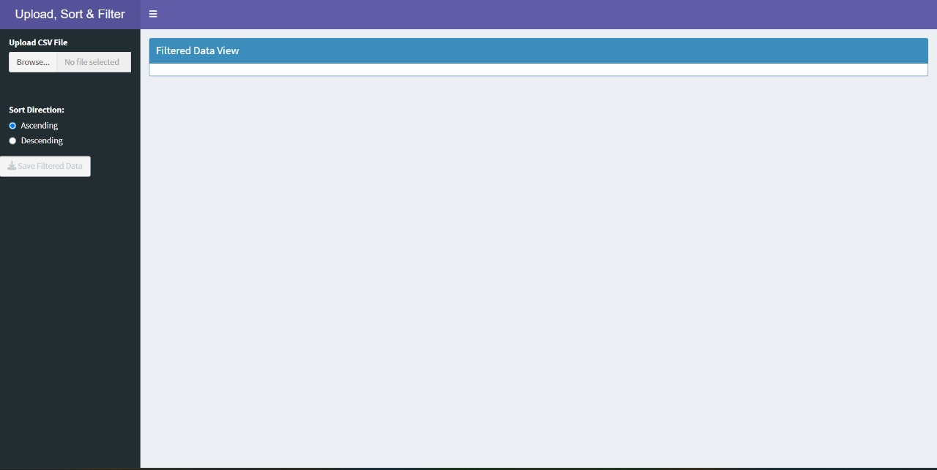
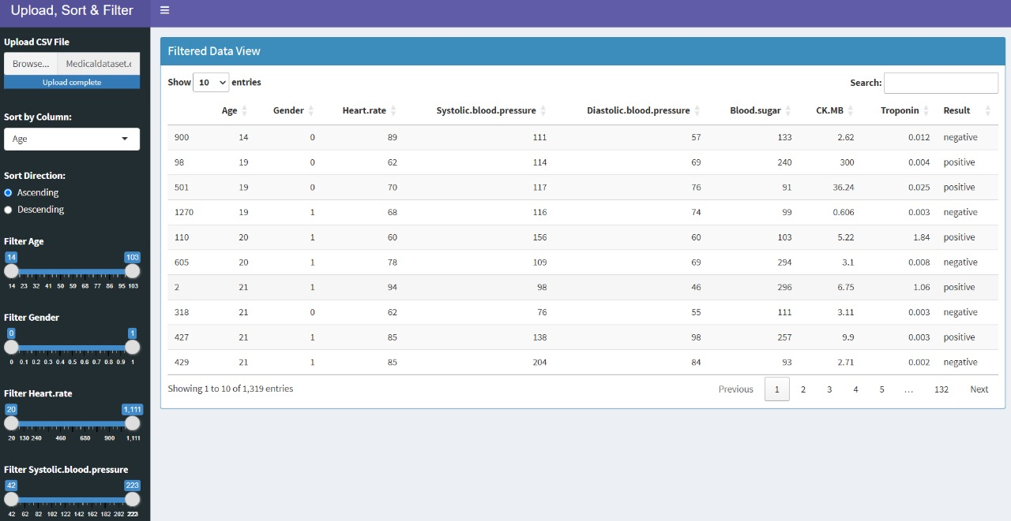

IMPLEMENTATION SCREENSHOTS
1)FILE UPLOAD
2)DATA VIEW

Slide 10


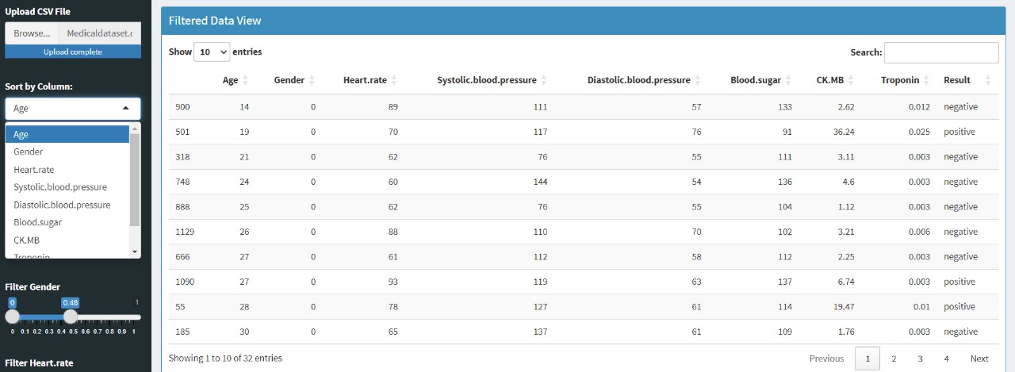
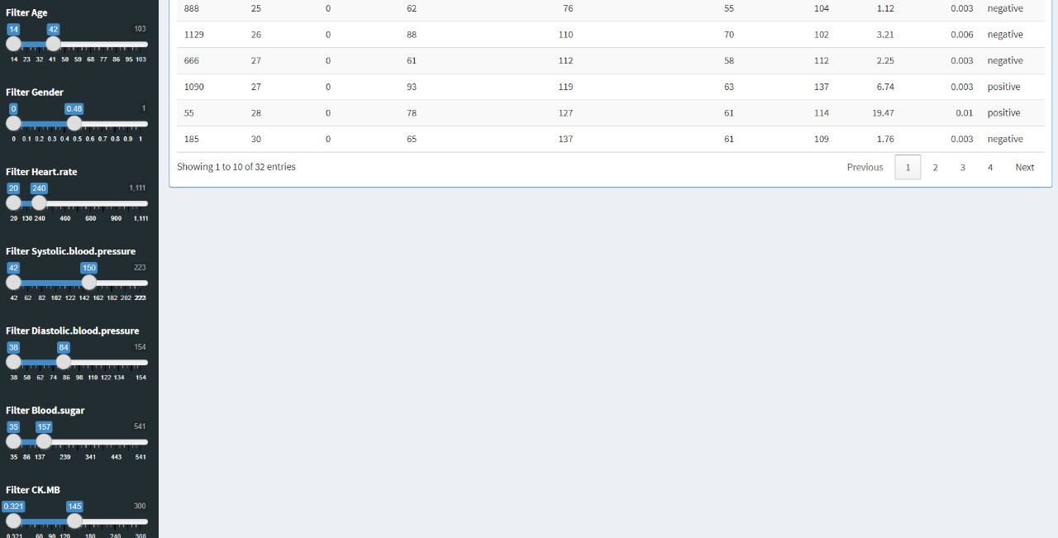
IMPLEMENTATION SCREENSHOTS
3) COLOUM SELECTION
4) SORTING AND FILTERING

Slide 11
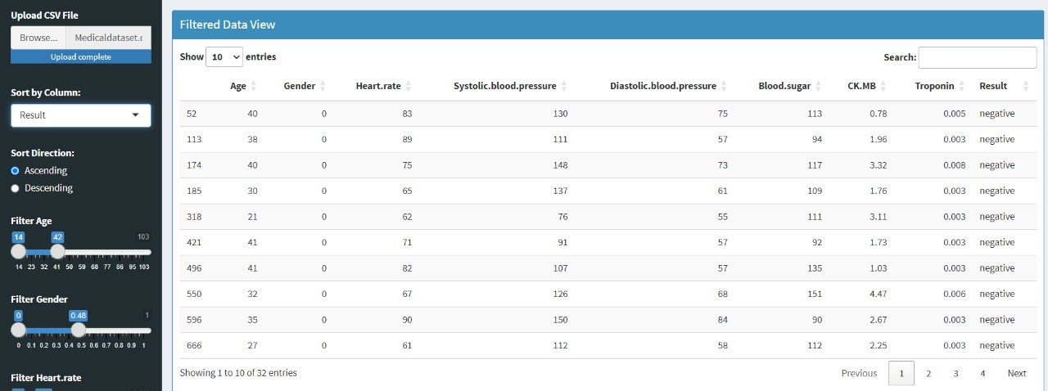
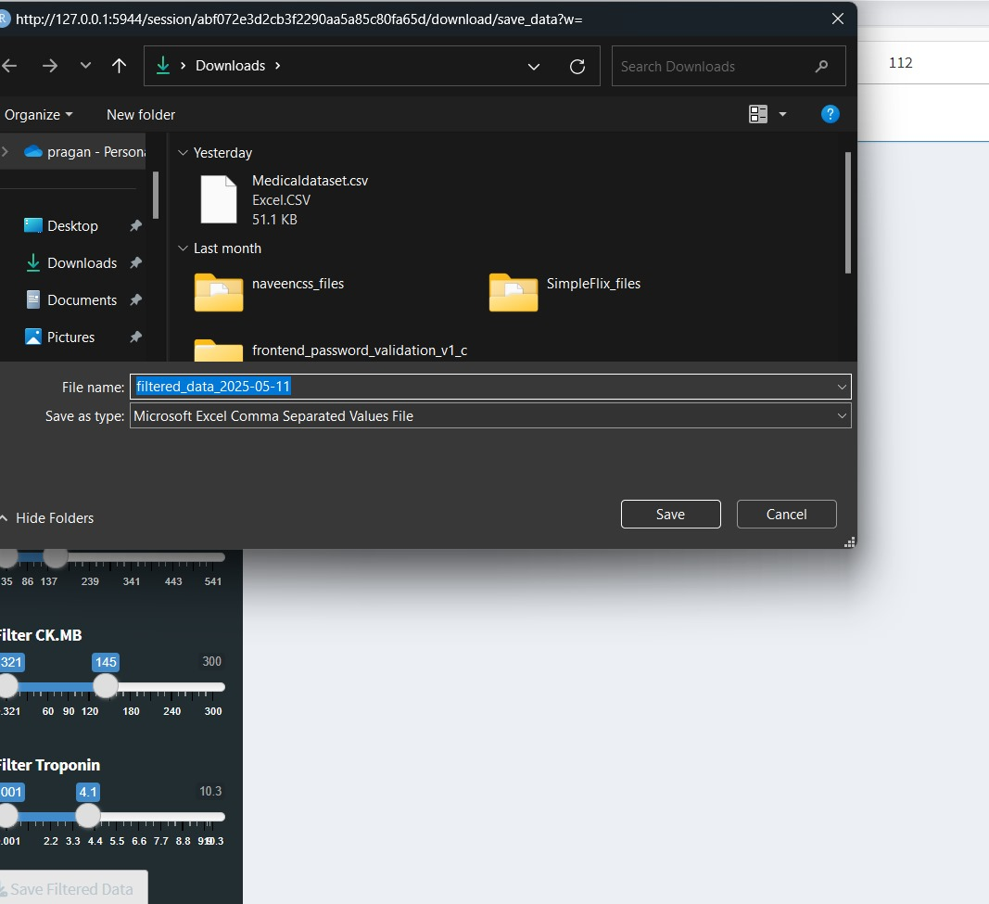
IMPLEMENTATION SCREENSHOTS
5) RESULT TABLE DISPLAY

Slide 12
CONCLUSION
The app provides an easy-to-use tool for exploring CSV datasets interactively. It eliminates the need for manual data wrangling via Excel or code. Users can quickly gain insights by sorting and filtering any uploaded dataset . The modular design allows for future enhancements like exporting filtered data . This tool is ideal for students, researchers, or analysts who work with CSV files.

Slide 13


